Slide 1







MR44
OUR TEAM
1
Social Networking and Wearable Fitness Technology
Jinfeng
Li
MA Computer Sciences
Team leader
and coding development
Xianwei
Lu
MA Computer Sciences
User Experience and Test Engineering
Zhenyu
Wang
MA Computer Sciences
Researcher and
Back-end development
Victor (Zihao)
Wang
MA Interaction Design
Interaction Design and Prototyping
Haoliang
Zhang
BA Information Technology
Front-end engineering development
Images of team members are generated by Peeps.[1] [1] “Peeps Avatar Builder @UI8.” http://peeps.ui8.net/ (accessed Aug. 29, 2023).
Notes:
We believe that the name Mr44 will help us become a united and efficient team
Our team is made up of four postgraduate students and one undergraduate student.
We all have a good foundation in computers and design to facilitate more efficient communication.
We come from different majors, which allows us to share knowledge and complement each other.
Our team members are Li Jinfeng, Xianwei Lu, Zhenyu Wang, Victor (Zihao) Wang and Haoliang Zhang.

Slide 2

2
Domain / Problem space
Economic Growth and Nutritional Levels
As economies around the world grow, the average nutritional levels in various countries are also increasing. Ironically, this increase in nutritional levels is leading to malnutrition in the form of overnutrition, which in turn is causing health problems such as obesity and heart disease.
Studies and Products on Exercise Motivation
There have been numerous studies and products aimed at motivating people to exercise.
Scarcity of Effective Tools
Despite the abundance of research and products, truly effective tools for motivating exercise are still scarce.
[2] “Premium Photo | Shirtless bodybuilder holding dumbell and showing his muscular arms.,” Freepik.
https://www.freepik.com/premium-photo/shirtless-bodybuilder-holding-dumbell-showing-his-muscular-arms_7906701.htm (accessed Aug. 29, 2023).
Notes:
With economic growth, the average nutritional levels of countries around the world are increasing. This leads to many people experiencing malnutrition, leading to diseases such as obesity and even heart disease. Although there have been many studies and products on motivational exercise, the truly effective tools among them are still scarce.

Slide 3


3
Design Opportunities
Intended Audience
Incentives
Sustainable exercise habit
Real-time information exchange
Online community sharing
Data Source Support
Lack motivation to exercise
Active social media users
Health-conscious people
(Icon from Microsoft office, accessed Aug. 29, 2023)
Notes:
The main direction of this design is to motivate people to develop sustainable exercise habits and find effective driving factors for those who lack exercise motivation.Based on this requirement, we plan to design a system consisting of software and hardware to motivate and monitor individual users' exercise performance.The main architecture of the software part is an online multi-user real-time information exchange platform, which connects each user by sharing the integrated data information in the online community. Users can communicate with each other and check their real-time status.On the other hand, we will design wearable devices to detect various types of data generated during movement, in order to support the data sources of online platforms.
People who lack motivation to exercise: Since the main direction of the design is to find effective drivers, it is particularly suitable for those who know the importance of exercise but lack sustained motivation.
Active Social Media Users: Considering that the software platform includes an online multi-user real-time information exchange community, those who enjoy social media and online interaction may find this system particularly appealing.
Health Conscious: For those who are already aware of the health problems that can result from over-nutrition and lack of exercise, such as obesity and heart disease, this system may be especially appealing.
()

Slide 4


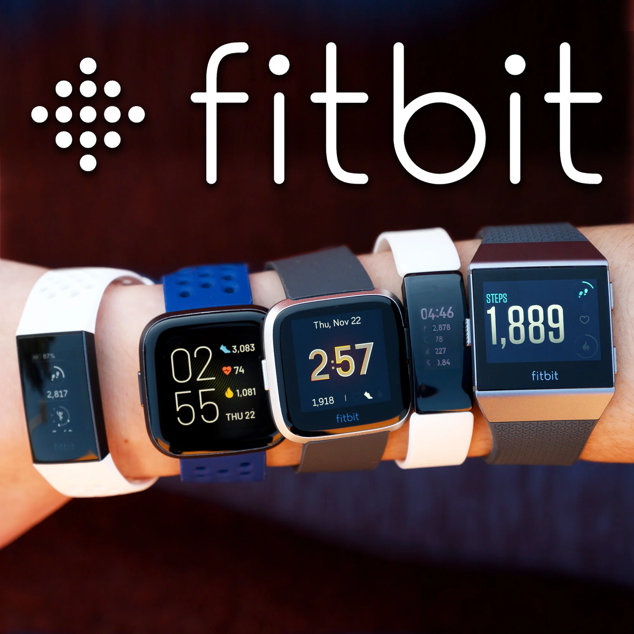
4
Social interaction
Main objectives
CONCEPT
Data-driven
Prescription
Figure 1: Pokémon [3]
Figure 2: fitbit [4]
[3] “How 2016 was for Pokémon and Pokémon Amino | Pokémon Amino,” Pokémon | aminoapps.com. https://aminoapps.com/c/pokemon/page/blog/how-2016-was-for-pokemon-and-pokemon-amino/ZzhB_uaZpEQo1QmnGKJMwr5aQa6ew (accessed Aug. 29, 2023).
[4] Strapcode, “The Fitbit Watch Story Part 1 : How it Rise and Collection Overviews,” Strapcode. https://www.strapcode.com/blogs/fitbit/the-fitbit-watch-story-part-1 (accessed Aug. 29, 2023).
Notes:
The concept can be divided into 4 key parts:
Main objectives
1.Motivate people to develop long-term, sustainable exercise habits.
2.Find effective drivers for people who lack motivation to exercise.
Prescription
1.Design of an online multi-user real-time information exchange platform
2.Developing wearable devices that are capable of collecting various types of data (e.g., heart rate, steps, etc.) during exercise and uploading that data to an online platform.
Social interaction
1.use social interaction and community support as motivators to increase user engagement and workout sustainability.
Data-driven
1.Real-time data monitoring and feedback enables users to better understand their workout performance so they can adjust and improve accordingly.
Pokémon Go.
Impact on Exercise: Although the game encourages users to get out and about, players may spend most of their time staring at the mobile screen rather than enjoying the outdoors.
Limited Social Interaction: The game's social features are relatively few, focusing mainly on battling and swapping Pokémon while lacking richer social interaction.
Fitbit
Battery Life: Although Fitbit's battery lasts longer than some of its competitors, it still requires regular charging. Certain features, such as continuous heart rate monitoring or connecting to GPS, may accelerate battery consumption.
Price: The relatively high cost of the Fitbit may deter some potential users.
Pokemon Go
A game uses the device's GPS to determine the player's location and presents a map that corresponds to the real world. As players move around, different types of Pokémon appear on the map at different times and in different places.
Fitbit
The product can not only track users' steps, activity time, and calorie consumption, but also monitor information such as heart rate, sleep quality, and exercise routes. These data are very helpful for users to set health goals, evaluate lifestyle, and plan for fitness.

Slide 5


5
Plan of work & methods
for discovery
Device Develop-ment
Design
research
User experience design
Data
analysis
Testing
(Icon from Microsoft office, accessed Aug. 29, 2023)
Notes:
We need to complete the following aspects:
Design research: collect and analyse the needs and suggestions of the target users, which is done through interviews, observations and questionnaires.
Device development: Develop hardware and software for wearable devices, including sensor selection, design, and application development.
User experience design: designing the user interface and interaction of the device to ensure that users can use the device intuitively.
Data analysis: Develop algorithms to analyse the user's exercise data and provide reasonable exercise advice and feedback.
Testing: Test the performance and stability of the device, collect user feedback, and continuously optimise the design and functionality of the device.
Through the above work, we hope to develop a wearable device that can accurately monitor the user's exercise status, provide personalised exercise advice and promote the user's long-term exercise motivation.

